Slide 1
Hydroponics
Indoor farming only

Slide 2
Benefits
Teaching the future generations nextgen farming styles
inspire them to create bigger
Protect against climate change
Keeping food away from nature to not disturb it
versatile
Modular
Interchangeable parts
Reusable
Scalable
Automated
Effort - almost none
Zero waste
Plants continue growing outside of vertical farm freely
Best overall cost
near free after initial investment

Slide 3
Future
vertical farming - ex’s
Agrarian society 2.0 - inside every home
Entire
mechanized automation
reusability - 0 waste
buildings in cities
<$
Growing - what’s typically not possible
Plants
Roots - at home - carrots, potatoes, etc.
>size - at >size farms - grains, trees, etc
methods
Space farming - O’Neill cylinders
Bioreactors
Aeroponics
Aerofarms - better products
Nutrient film
Membrane Meniscus Method
Direction, ideal
Foraging
w/ - rewilding
Indoor farming
Vertical farming
Hydroponics
aeroponics
Bioreactors
Algae
Cultured cells - plants
Avoid food = <harming life
Non-living
Ex - digital food - VR
Less food
Ex - nutrient dense

Slide 4
Holistic system - ideal
Food - sources
Foraging
From - rewilding
indoor farming
Like - vertical farming
Non-living, <size
VR - e-food
Setup
Seeds
Sprouts
Microgreens
farming
10% experimental
Algae - bioreactors
Solar - agrovoltaics
Non-living food

Slide 5
Flexible
Foods - sources
Growing medium
Type of setup
Levels - stack
Spread out
Turn 2 sq ft into 16 sq ft
Make use of existing space
Vines on posts
Algaeponics
Lighting
plants
Soaked seeds
1 - Sprouts
2 - Microgreens
Crops (leaves, vegetables, etc.)
Sizes
3 - Small
4-6 - Full-size
Algae
Water plants
Bonsai trees
#’s - plant growth stages

Slide 6
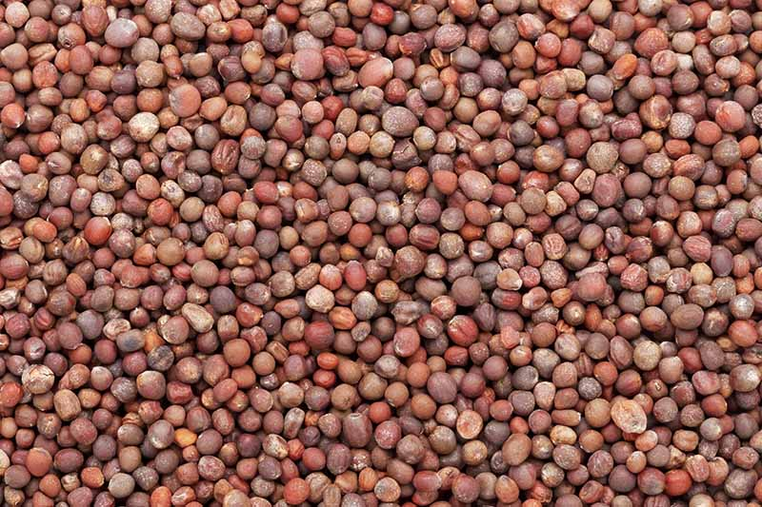
Stages of plant growth
Broccoli seed
https://growjourney.s3.amazonaws.com/Img/Blog/February%202018/Screen%20Shot%202018-02-01%20at%203.01.37%20PM.png

Slide 7
algaeponics
Benefits
No extra space
Goes in aerovoir
plants
Balances nutrient levels
= healthier plants
Supplements missing nutrients - like protein
Self-sustaining
<bad algae growth
Options (including, not limited to):
Spirulina (1, 2, 3)
duckweed
Chlorella
Future of vertical farming
Crops + bioreactor in one!

Slide 8
Costs
Only worries
Systems
upfront build
fertilizer
Sprouts - seeds
Avoid - take from systems
Avoid everything else once setup
Extra modules (see next slide)
free
Seeds - collection
Electricity - Solar panel + battery
Fertilizer - only cost, but is $20 for 5 years
Water - rainwater filtration
No
Dehumidifier
farmed bees

Slide 9
ROI (Return on Investment)
Equations
$[spent = saved] = ROI
# of times = ROI
1 - uses = price of setup/price of food
2 - rounds = ROI uses/round uses
food | sale $ | setup | # of Uses | Math - 1 | # rounds | Math - 2 | time
sprouts | £1/bag | sprouter | 15 | £15/£1 | <1 | 15/16 | immediate
Sprouts or soaking |  | jars | 2.43 | (£47.40 + £10.99)/24 = £2.43/£1 | >0.1 | 2.43/24 | immediate
microgreens | £4/box | tray | 0.96 | £22.99/6 = £3.83/£4 | 0.48 | 0.96/2 | immediate
vegetables | £1/bag | garden | 875.19 | £875.19/£1 | 29.17 | 875.19/30 | months
 |  | tower | 850 | £850/£1 | 10.63 | 850/80 | months

Slide 10
Players in the field

Slide 11
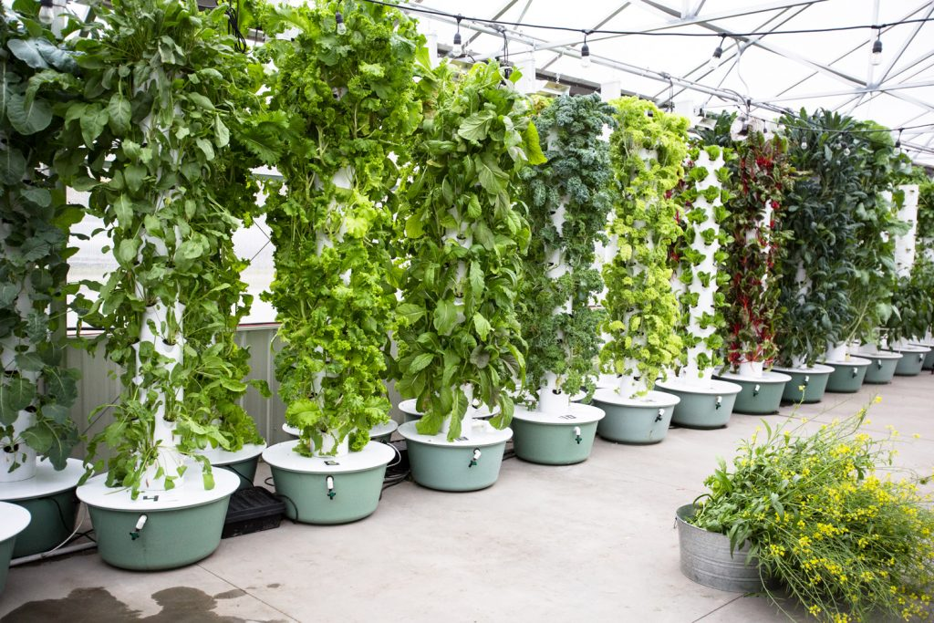
VeganVille
The company that’s creating the setup
Has vertical farming goals
Completely, 100% vegan
Vegan real estate community builder
veganville.info

Slide 12
Brittany Bunk
Inspired at 6yrs old:
Grandparent’s farm
Grandparent’s organized lettuce/tomato farm
Grew plants, like aloe, for medicine
Farmed into their 80s/90s
Ability to pick and choose what you want
Tasted and was better than a grocery store
Went on - Living with the Land ride - at EPCOT
w/ - ‘behind the seeds’ tour
Grew up in - New England
Desired to build upon it all at home
Futuristic investor
Investor in VeganVille
30.5 years old
Retired at 27
Worked 70+ jobs
volunteered 1000s of positions
Environmental Health Science Bachelor’s degree from CSUSB
http://brittany-bunk.weebly.com/hydroponics.html

Slide 13
Vertical farm experience
volunteering at farms:
UCSB
Placed ladybugs on strawberries for pollination
Community garden - saw brussel sprouts grow
Ontario, CA - Amy’s Farm
Educational tour and met farm owner there
Picked crops
designed backyard garden for neighbor - 10 years old
learning
Farmer’s market
Running a microgreens business with a microgreens booth - bought them seeds and researched containers/soil alternatives
Saw the tower garden used at another booth (in a picture)
LA County Fair
Saw different hydroponic setups, plants grown, and applications/integration
Insider information on the latest and greatest
Toured LGS (Local Grown Salads) setup
Discussed vertical farm funding rounds with 361firm

Slide 14
Vertical Farming Experience - Part 2
R&D
Designs
history
Designing in my own mind
Living with the Land ride at EPCOT
Behind the seeds
By - Tower Garden
Investment - stocks
Aerofarms when it was a stock: SV - Spring Valley Acquisition
Foundation Farms: GMEV

Slide 15
Part 3
Growing on my own
indoors
Mini greenhouse
Soil pots
Hydroponically - aerogarden
Outdoors
Plant sanctuary - rescues London Rocket, pineapply aloe, nopales cactus
Forages weeds - believes that nothing should be labeled negatively, like ‘weeds’, ‘pests’, monsters, etc., but everything has a value, based on its use

Slide 16
School Setup

Slide 17
Process: circular
Students: grow seedlings at home
Classroom: seedlings go into hydroponic garden
Canteen: larger plants transfer to a tower
Greenhouse:
Canteen: sprouts
students: microgreen trays

Slide 18
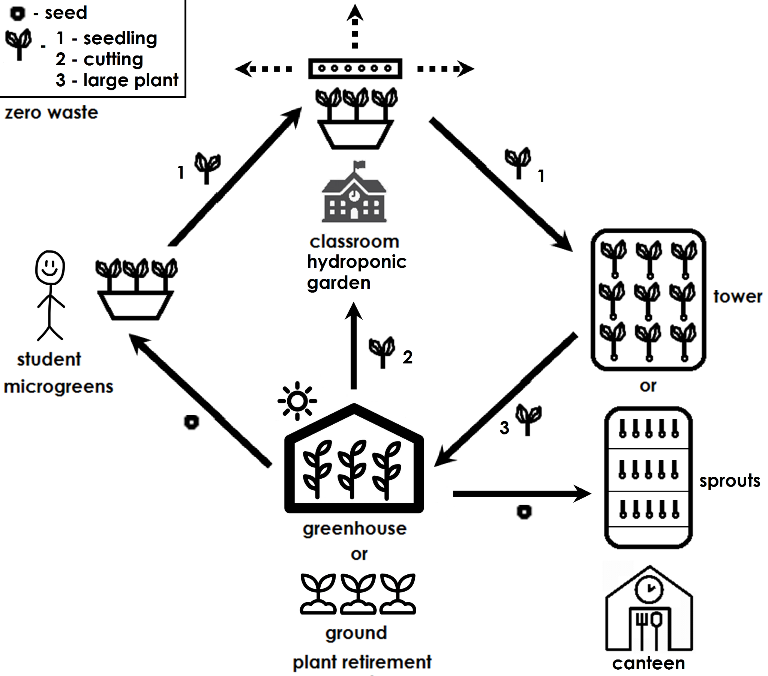

Slide 19
Home - Students

Slide 20
Microgreens/sprouts: reasons
Quick growing time
No
Soil alternative - only water
Fertilizer - seeds have everything they need
Flexibility in options
Bring it to school’s hydroponics
Plant in garden
Eat
Start small to grow into bigger
Makes them excited and cherish bigger investments if they do it themselves - like grow lights, fertilizer, aerogardens, towers, etc. for their own home

Slide 21
Sprouter
Microgreens
Simplest - sprouting jar
Mason jar (£47.40 / 24 pack) + mesh for lid (£10.99)
Better - microgreens tray (6 for £22.99 = £3.83/person)
Can give led strips (£9.99) (strips)
if able to handle the light

Slide 22
No hydroponic systems - reasons
>>
Expensive
Complicated
Wouldn’t know what to do with the equipment
Esp - after, when done
As seen in the 2ndary market
Much
Risk of damaging it
Maintenance
Lights
may bother - students, their family
Might not be for them
They can see the hydroponics at the school
Learn - hydroponics together - mistakes, achievements, etc.

Slide 23
School

Slide 24
Agrovoltaics - electricity
Solar panel - £284.77
Portable power station w/ AC port and % amount - £100-300
Example - https://www.amazon.co.uk/Portable-Station-40800mAh-Flashlight-Emergency/dp/B08P7C64M3
Reason - avoid plug adapter
Has AC port
= £300-500

Slide 25
Classroom - hydroponic garden
AeroVoir (£46.24)
Solder - poke hole
3d print - plug
Rubber - stopper
Plug adapter
US plug
Avoid if using batteries from solar
Solar panel + battery
Aluminum foil
Can do growing lights instead - faster
Poke holes
Spray mister
Optional - tracing paper
Replacement
Net cups + sponges (£13.99)
Might be able to do w/o cups
Seeds/algae cultures
Fertilizer
Drip irrigation cord (£6.99)
Tomatoes - bee pollinator (£19.12)
Or - electric toothbrush
Strawberries - wood chips
Ideal - AeroGarden Farm 24Plus (£875.19) for each classroom
Reason - stackable
Good for craft room - 1 for entire school
Cheapest versions - each classroom
£120 on amazon
Cheaper on ebay or fb
Reason - people have no use when done
Will get cheaper over time
Accessories:

Slide 26
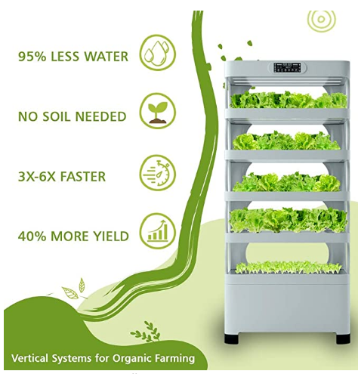
Canteen

Slide 27
hydroponic towers
Sprouters
Nutrabinns - have to be shipped to me - a US location - $3000 total
Tower garden. Agrotonomy - ships to UK - unsure of legitimacy - £850
Even has a school program
Sprouter (£14.99 * 9000/16 = £8431.86 - but not everyone will eat sprouts - <$)
Needs - lots of seeds
Quickest, cheapest
Continuous
Grow time - every 2-3 days
Add soil/bamboo mat -> empty row -> extra tray
Notes:
Sprouts - opt
Mister
Aluminum foil
Bamboo mat
easy - no/little
Special tending to
Growing time
Lights
Nutrients
Space
Electricity
Land
Waste - all of the plant’s eaten

Slide 28
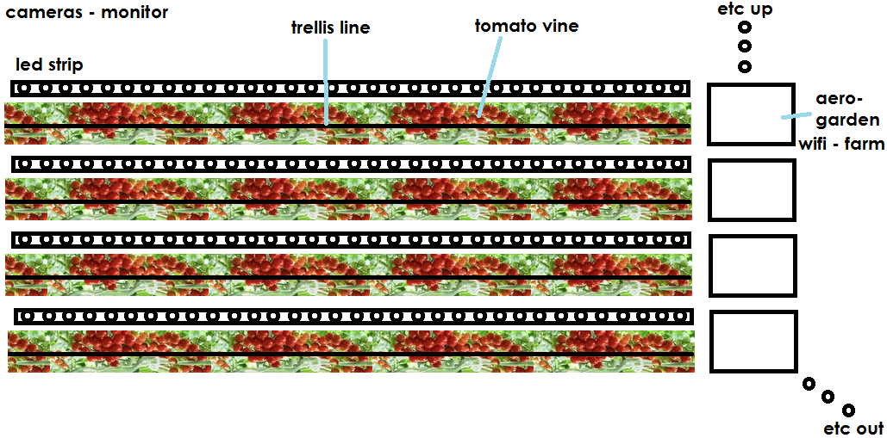
warehouse
Notes: Might need
aerogarden - on other side
bee the bee pollinator
ring - to water bin - to raise it - for the roots
Supports if gets too high

Slide 29
Plant list - Sprout (cost analysis) (fav’s - *, extra *’s - = >)
Avoid
Pea
Radish
Herbs - like **chervil (winter), *papalo
Chia
Papaya
Nightshade - tomato
Corn
Rice
Beans
Soy
Brassicas (except kale)
Alliums - garlic, etc.
(*some) Weeds - purslane, etc.
Wheatgrass
Lentils
Jute
Hemp
Spaghetti squash
Good
*Basil
alfalfa
*Sunflower
**Meyer lemon
*Beet - bull’s blood
Kale
Oat grass
*Melon - water, canteloupe
Lettuce
*clover
Maybe
Flax
Lavender
Cucumber
Mung
Carrot
Cilantro
*Chamomile - pineapple
*Amaranth
Oat
*buckwheat
Millet
sesame
Notes:
Maybe
I haven’t tried before - or tricky, not as likeable
Basil - quickest sprouting/growing
Alfalfa - quintessential
Mung - large, great tasting - >protein
Lemon - best tasting
Fruit seedlings - like melons - taste like fruit itself
Kale - great for growing into bigger plant
Cucumber - easy to sprout
Chervil tastes great - but so long to grow
Papalo - hard to sprout Rice doesn’t sprout
Soy - allergenic (mung is the same, tastes better too)
Brassicas - don’t taste as great (if people like the taste, then it’s a maybe)
Lentils - abrasive - on teeth
Jute - same issue
Garlic, etc. come from bulbs, not seeds
Wheatgrass - little allergenic, harsh tasting - tangy strong
Hemp - associated with drugs - pychoactive chemicals - bad for kids
Buckwheat - hard to transfer
Reason - flimsy
Tastes great

Slide 30
Plant list cont. - vine - warehouse
tomatoes
peas
cucumbers
grapes
mint
bell pepper
strawberry
papalo
melons
okra
eggplant
goji berry
currant?
lentils, beans - chickpeas
thyme?
Chamomile
Potato
Kiwi
Nasturtium
Passionfruit
Loofah
Malabar spinach
Jasmine
Chayote squash
Notes:
Maybe
I haven’t tried before - or tricky, not as likeable
Basil - quickest sprouting/growing
Alfalfa - quintessential
Mung - large, great tasting - >protein
Lemon - best tasting
Fruit seedlings - like melons - taste like fruit itself
Kale - great for growing into bigger plant
Cucumber - easy to sprout
Chervil tastes great - but so long to grow
Papalo - hard to sprout Rice doesn’t sprout
Soy - allergenic (mung is the same, tastes better too)
Brassicas - don’t taste as great (if people like the taste, then it’s a maybe)
Lentils - abrasive - on teeth
Jute - same issue
Garlic, etc. come from bulbs, not seeds
Wheatgrass - little allergenic, harsh tasting - tangy strong
Hemp - associated with drugs - pychoactive chemicals - bad for kids

